Slide 1
Properties of Matter
Chapter 4

Slide 2
Physical properties
Characteristics that can be evaluated without changing the composition of the material.
Examples
color - density
odor - melting point
taste - boiling point
feel - compressibility

Slide 3
Examples of Physical Properties

Slide 4
Chemical Properties
Result in a change in the composition of a material.
Chemical Reaction - how the change occurs.
Example A chemical property of wood is it’s ability to burn - combustion.
(Reactants and Products are very different)

Slide 5
Changes
Physical Changes - can be carried out without changing the composition of a substances.
Chemical Changes – are changes that change the composition of a substance.

Slide 7
Which are chemical or physical changes?
Mulching leaves
Milk turning sour
Making wine
Making ice water
Beer going flat
Leaves changing color

Slide 8
Energy
Energy is the capacity to do work.
Types of energy
Kinetic energy
Potential energy
Thermal energy
Measured in Joules or Calories

Slide 9
Temperature and Heat
Temperature is a measure of average kinetic energy
Heat is a measure of total energy

Slide 10
Specific Heat
the amount of heat required to change the temperature of a substance by a specified amount.
Specific heats
water 1.0 cal/g ºC or 4.184 J/g ºC
Al 0.216 cal/g ºC or 0.902 J/g ºC
Cu 0.092 cal/g ºC or 0.385 J/g ºC
Fe 0.113 cal/g ºC or 0.473 J/g ºC
Au 0.031 cal/g ºC or 0.131 J/g ºC

Slide 11
Law of Conservation of Energy
Energy can be neither created nor destroyed.

Slide 12
Law of conservation of Mass and Energy
The sum on mass and energy is conserved.

Slide 13
Energy and Food

Slide 14
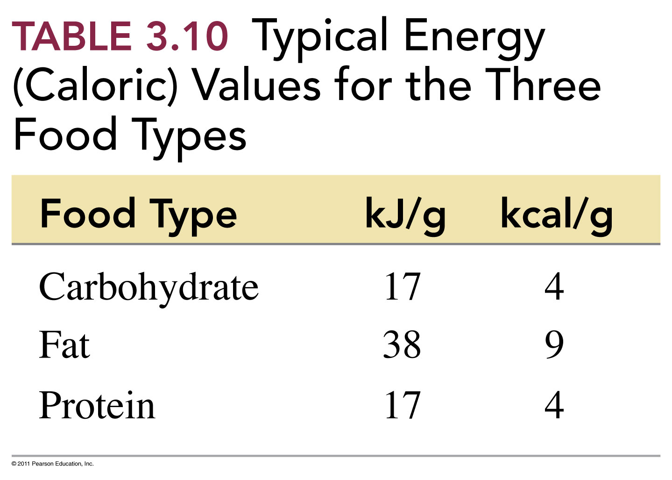

Slide 15
How many calories will you get from eating one slice of pizza?

Slide 16
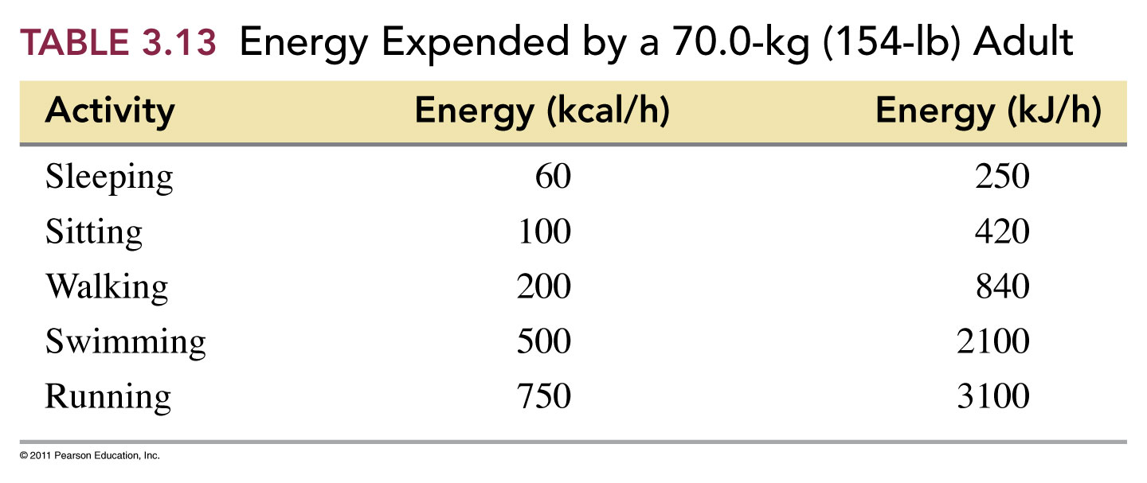
How long must you swim to use up the energy that you get from a piece of pizza?

Slide 17
Does the calories from fat make sense?

